Slide 1
Secure Distributed Framework for Achieving ϵ-Differential Privacy
Dima Alhadidi, Noman Mohammed, Benjamin C. M. Fung, and Mourad Debbabi
Concordia Institute for Information Systems Engineering
Concordia University, Montreal, Quebec, Canada
{dm_alhad,no_moham,fung,debbabi}@encs.concordia.ca

Slide 2
Outline
Motivation
Problem Statement
Related Work
Background
Two-Party Differentially Private Data Release
Performance Analysis
Conclusion

Slide 3
Outline
Motivation
Problem Statement
Related Work
Background
Two-Party Differentially Private Data Release
Performance Analysis
Conclusion

Slide 4
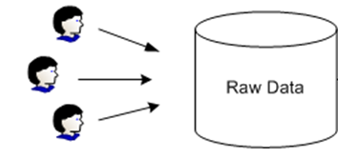
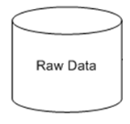
Motivation
Centralized
Individuals
Data Publisher
Anonymization Algorithm
Data Recipients
Distributed

Slide 5
Motivation
Distributed: Vertically-Partitioned
ID | Job
1 | Writer
2 | Dancer
3 | Writer
4 | Dancer
5 | Engineer
6 | Engineer
7 | Engineer
8 | Dancer
9 | Lawyer
10 | Lawyer
ID | Sex | Salary
1 | M | 30K
2 | M | 25K
3 | M | 35K
4 | F | 37K
5 | F | 65K
6 | F | 35K
7 | M | 30K
8 | F | 44K
9 | M | 44K
10 | F | 44K

Slide 6
Motivation
Distributed: Vertically-Partitioned
ID | Job | Sex | Salary
1 | Writer | M | 30K
2 | Dancer | M | 25K
3 | Writer | M | 35K
4 | Dancer | F | 37K
5 | Engineer | F | 65K
6 | Engineer | F | 35K
7 | Engineer | M | 30K
8 | Dancer | F | 44K
9 | Lawyer | M | 44K
10 | Lawyer | F | 44K

Slide 7
Motivation
Distributed: Horizontally-Partitioned
ID | Job | Sex | Age | Surgery
1 | Janitor | M | 34 | Transgender
2 | Lawyer | F | 58 | Plastic
3 | Mover | M | 58 | Urology
4 | Lawyer | M | 24 | Vascular
5 | Mover | M | 34 | Transgender
6 | Janitor | M | 44 | Plastic
7 | Doctor | F | 44 | Vascular
ID | Job | Sex | Age | Surgery
8 | Doctor | M | 58 | Plastic
9 | Doctor | M | 24 | Urology
10 | Janitor | F | 63 | Vascular
11 | Mover | F | 63 | Plastic

Slide 8
Motivation
Distributed: Horizontally-Partitioned
ID | Job | Sex | Age | Surgery
1 | Janitor | M | 34 | Transgender
2 | Lawyer | F | 58 | Plastic
3 | Mover | M | 58 | Urology
4 | Lawyer | M | 24 | Vascular
5 | Mover | M | 34 | Transgender
6 | Janitor | M | 44 | Plastic
7 | Doctor | F | 44 | Vascular
8 | Doctor | M | 58 | Plastic
9 | Doctor | M | 24 | Urology
10 | Janitor | F | 63 | Vascular
11 | Mover | F | 63 | Plastic

Slide 9
Motivation
Distributed: Horizontally-Partitioned
ID | Job | Sex | Age | Surgery
1 | Janitor | M | 34 | Transgender
2 | Lawyer | F | 58 | Plastic
3 | Mover | M | 58 | Urology
4 | Lawyer | M | 24 | Vascular
5 | Mover | M | 34 | Transgender
6 | Janitor | M | 44 | Plastic
7 | Doctor | F | 44 | Vascular
8 | Doctor | M | 58 | Plastic
9 | Doctor | M | 24 | Urology
10 | Janitor | F | 63 | Vascular
11 | Mover | F | 63 | Plastic

Slide 10
Motivation
Distributed: Horizontally-Partitioned
ID | Job | Sex | Age | Surgery
1 | Janitor | M | 34 | Transgender
2 | Lawyer | F | 58 | Plastic
3 | Mover | M | 58 | Urology
4 | Lawyer | M | 24 | Vascular
5 | Mover | M | 34 | Transgender
6 | Janitor | M | 44 | Plastic
7 | Doctor | F | 44 | Vascular
8 | Doctor | M | 58 | Plastic
9 | Doctor | M | 24 | Urology
10 | Janitor | F | 63 | Vascular
11 | Mover | F | 63 | Plastic

Slide 11
Motivation
Distributed: Horizontally-Partitioned
ID | Job | Sex | Age | Surgery
1 | Janitor | M | 34 | Transgender
2 | Lawyer | F | 58 | Plastic
3 | Mover | M | 58 | Urology
4 | Lawyer | M | 24 | Vascular
5 | Mover | M | 34 | Transgender
6 | Janitor | M | 44 | Plastic
7 | Doctor | F | 44 | Vascular
8 | Doctor | M | 58 | Plastic
9 | Doctor | M | 24 | Urology
10 | Janitor | F | 63 | Vascular
11 | Mover | F | 63 | Plastic

Slide 12
Outline
Motivation
Problem Statement
Related Work
Background
Two-Party Differentially Private Data Release
Performance Analysis
Conclusion

Slide 13
Problem Statement
Desideratum to develop a two-party data publishing algorithm for horizontally-partitioned data which :
achieves differential privacy and
satisfies the security definition of secure multiparty computation (SMC).

Slide 14
Outline
Motivation
Problem Statement
Related Work
Background
Two-Party Differentially Private Data Release
Performance Analysis
Conclusion

Slide 15
Related Work
Algorithms | Data Owner |  |  | Privacy Model
 | Centralized | Distributed |  | Differential Privacy | Partition-based Privacy
 |  | Horizontally | Vertically
LeFevre et al., Fung et al., etc | √ |  |  |  | √
Xiao et al. , Mohammed et al. , etc. | √ |  |  | √
Jurczyk and Xiong, Mohammed et al. |  | √ |  |  | √
Jiang and Clifton, Mohammed et al. |  |  | √ |  | √
Our proposal |  | √ |  | √

Slide 16
Outline
Motivation
Problem Statement
Related Work
Background
Two-Party Differentially Private Data Release
Performance Analysis
Conclusion

Slide 17
k-Anonymity
Raw patient table
Job | Sex | Age | Disease
Engineer | Male | 35 | Fever
Engineer | Male | 38 | Fever
Lawyer | Male | 38 | Hepatitis
Musician | Female | 30 | Flu
Musician | Female | 30 | Hepatitis
Dancer | Female | 30 | Hepatitis
Dancer | Female | 30 | Hepatitis

Slide 18
k-Anonymity
Quasi-identifier (QID)
Raw patient table
Job | Sex | Age | Disease
Engineer | Male | 35 | Fever
Engineer | Male | 38 | Fever
Lawyer | Male | 38 | Hepatitis
Musician | Female | 30 | Flu
Musician | Female | 30 | Hepatitis
Dancer | Female | 30 | Hepatitis
Dancer | Female | 30 | Hepatitis

Slide 19
k-Anonymity
Raw patient table
Job | Sex | Age | Disease
Engineer | Male | 35 | Fever
Engineer | Male | 38 | Fever
Lawyer | Male | 38 | Hepatitis
Musician | Female | 30 | Flu
Musician | Female | 30 | Hepatitis
Dancer | Female | 30 | Hepatitis
Dancer | Female | 30 | Hepatitis
3-anonymous patient table
Job | Sex | Age | Disease
Professional | Male | [36-40] | Fever
Professional | Male | [36-40] | Fever
Professional | Male | [36-40] | Hepatitis
Artist | Female | [30-35] | Flu
Artist | Female | [30-35] | Hepatitis
Artist | Female | [30-35] | Hepatitis
Artist | Female | [30-35] | Hepatitis

Slide 20
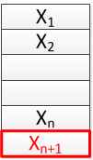
Differential Privacy
D
D′

Slide 21
Laplace Mechanism
D

Slide 22
Exponential Mechanism
McSherry and Talwar have proposed the exponential mechanism that can choose an output that is close to the optimum with respect to a utility function while preserving differential privacy.

Slide 23
Outline
Motivation
Problem Statement
Related Work
Background
Two-Party Differentially Private Data Release
Performance Analysis
Conclusion

Slide 24
Two-Party Differentially Private Data Release
Generalizing the raw data
Adding noisy count

Slide 25
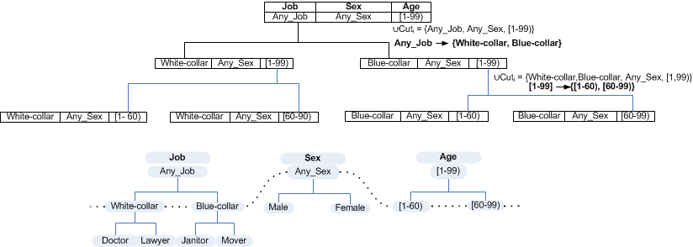
Generalizing the raw data
Distributed Exponential Mechanism
(DEM)

Slide 26
Generalization
Distributed Exponential Mechanism
(DEM)

Slide 27
Adding Noisy Count
Each party adds a Laplace noise to its count .
Each party sends the result to the other party.

Slide 28
Two-Party Protocol for Exponential Mechanism
Input:
Two raw data sets by two parties
Set of candidates
Privacy budget
Output : Winner candidate

Slide 29
Max Utility Function
ID | Class | Job | Sex | Age | Surgery
1 | N | Janitor | M | 34 | Transgender
2 | Y | Lawyer | F | 58 | Plastic
3 | Y | Mover | M | 58 | Urology
4 | N | Lawyer | M | 24 | Vascular
5 | Y | Mover | M | 34 | Transgender
6 | Y | Janitor | M | 44 | Plastic
7 | Y | Doctor | F | 44 | Vascular
Max | Class |  | Job | Data Set
 | Y | N
5 | 3 | 1 | Blue-collar | D₁
 | 2 | 1 | White-collar
3 | 2 | 0 | Blue-collar | D₂
 | 1 | 1 | White-collar
8 | 5 | 1 | Blue-collar | Integrated D₁ and D₂
 | 3 | 2 | White-collar
D₁

Slide 30
Max Utility Function
ID | Class | Job | Sex | Age | Surgery
8 | N | Doctor | M | 58 | Plastic
9 | Y | Doctor | M | 24 | Urology
10 | Y | Janitor | F | 63 | Vascular
11 | Y | Mover | F | 63 | Plastic
Max | Class |  | Job | Data Set
 | Y | N
5 | 3 | 1 | Blue-collar | D₁
 | 2 | 1 | White-collar
3 | 2 | 0 | Blue-collar | D₂
 | 1 | 1 | White-collar
8 | 5 | 1 | Blue-collar | Integrated D₁ and D₂
 | 3 | 2 | White-collar
D₂

Slide 31
Max Utility Function
ID | Class | Job | Sex | Age | Surgery
1 | N | Janitor | M | 34 | Transgender
2 | Y | Lawyer | F | 58 | Plastic
3 | Y | Mover | M | 58 | Urology
4 | N | Lawyer | M | 24 | Vascular
5 | Y | Mover | M | 34 | Transgender
6 | Y | Janitor | M | 44 | Plastic
7 | Y | Doctor | F | 44 | Vascular
8 | N | Doctor | M | 58 | Plastic
9 | Y | Doctor | M | 24 | Urology
10 | Y | Janitor | F | 63 | Vascular
11 | Y | Mover | F | 63 | Plastic
Max | Class |  | Job | Data Set
 | Y | N
5 | 3 | 1 | Blue-collar | D₁
 | 2 | 1 | White-collar
3 | 2 | 0 | Blue-collar | D₂
 | 1 | 1 | White-collar
8 | 5 | 1 | Blue-collar | Integrated D₁ and D₂
 | 3 | 2 | White-collar
D₁ & D₂

Slide 32
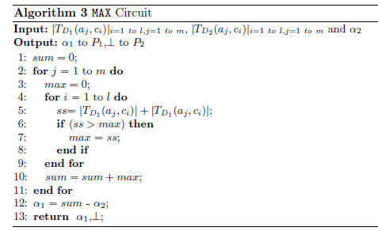
Computing Max Utility Function
Blue-collar
Max | Class |  | Job | Data Set
 | Y | N
5 | 3 | 1 | Blue-collar | D₁
 | 2 | 1 | White-collar
3 | 2 | 0 | Blue-collar | D₂
 | 1 | 1 | White-collar
8 | 5 | 1 | Blue-collar | Integrated D₁ and D₂
 | 3 | 2 | White-collar

Slide 33
Computing Max Utility Function
max=1 Blue-collar
Max | Class |  | Job | Data Set
 | Y | N
5 | 3 | 1 | Blue-collar | D₁
 | 2 | 1 | White-collar
3 | 2 | 0 | Blue-collar | D₂
 | 1 | 1 | White-collar
8 | 5 | 1 | Blue-collar | Integrated D₁ and D₂
 | 3 | 2 | White-collar

Slide 34
Computing Max Utility Function
max=1 Blue-collar
Max | Class |  | Job | Data Set
 | Y | N
5 | 3 | 1 | Blue-collar | D₁
 | 2 | 1 | White-collar
3 | 2 | 0 | Blue-collar | D₂
 | 1 | 1 | White-collar
8 | 5 | 1 | Blue-collar | Integrated D₁ and D₂
 | 3 | 2 | White-collar

Slide 35
Computing Max Utility Function
max=5, sum=5 Blue-collar
Max | Class |  | Job | Data Set
 | Y | N
5 | 3 | 1 | Blue-collar | D₁
 | 2 | 1 | White-collar
3 | 2 | 0 | Blue-collar | D₂
 | 1 | 1 | White-collar
8 | 5 | 1 | Blue-collar | Integrated D₁ and D₂
 | 3 | 2 | White-collar

Slide 36
Computing Max Utility Function
sum=5 White-collar
Max | Class |  | Job | Data Set
 | Y | N
5 | 3 | 1 | Blue-collar | D₁
 | 2 | 1 | White-collar
3 | 2 | 0 | Blue-collar | D₂
 | 1 | 1 | White-collar
8 | 5 | 1 | Blue-collar | Integrated D₁ and D₂
 | 3 | 2 | White-collar

Slide 37
Computing Max Utility Function
max=2, sum=5 White-collar
Max | Class |  | Job | Data Set
 | Y | N
5 | 3 | 1 | Blue-collar | D₁
 | 2 | 1 | White-collar
3 | 2 | 0 | Blue-collar | D₂
 | 1 | 1 | White-collar
8 | 5 | 1 | Blue-collar | Integrated D₁ and D₂
 | 3 | 2 | White-collar

Slide 38
Computing Max Utility Function
max=2, sum=5 White-collar
Max | Class |  | Job | Data Set
 | Y | N
5 | 3 | 1 | Blue-collar | D₁
 | 2 | 1 | White-collar
3 | 2 | 0 | Blue-collar | D₂
 | 1 | 1 | White-collar
8 | 5 | 1 | Blue-collar | Integrated D₁ and D₂
 | 3 | 2 | White-collar

Slide 39
Computing Max Utility Function
max=3, sum=8 White-collar
Max | Class |  | Job | Data Set
 | Y | N
5 | 3 | 1 | Blue-collar | D₁
 | 2 | 1 | White-collar
3 | 2 | 0 | Blue-collar | D₂
 | 1 | 1 | White-collar
8 | 5 | 1 | Blue-collar | Integrated D₁ and D₂
 | 3 | 2 | White-collar
Result: Shares α₁ and α₂

Slide 40
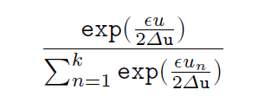
Computing the Exponential Equation
Given the scores of all the candidates, exponential mechanism selects the candidate having score u with the following probability:
Shares α₁ and α₂

Slide 41
Computing the Exponential Equation
Taylor Series
=
=

Slide 42
Computing the Exponential Equation
Lowest common multiplier of {2!,…,w!}, no fraction
Approximating up to a predetermined number s
after the decimal point

Slide 43
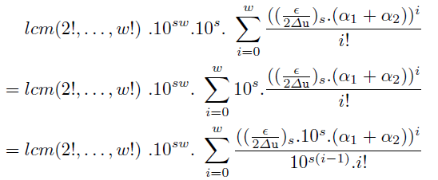
Computing the Exponential Equation
No fraction

Slide 44
Computing the Exponential Equation
First Party
Oblivious Polynomial Evaluation
Second Party
Result
First Party
Second Party

Slide 45
Computing the Exponential Equation
First Party
Second Party

Slide 46
Computing the Exponential Equation
Picking a random number
[0,1]
0
1
0.2
0.3
0.5
0.7

Slide 47
Computing the Exponential Equation
Picking a random number
[0, ]
0

Slide 48
Picking a Random Number
First Party
Second Party
Random Value Protocol
[Bunn and Ostrovsky 2007]
First Party
Second Party

Slide 49
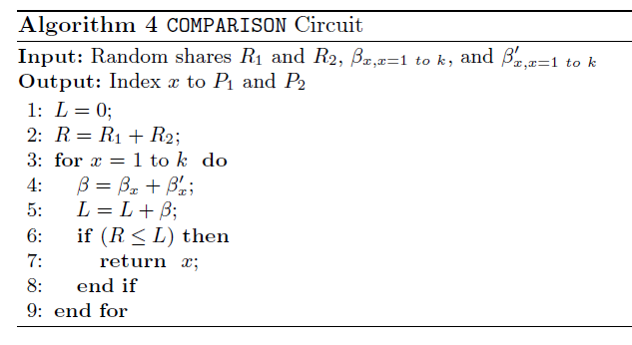
Picking a Winner

Slide 50
Outline
Motivation
Problem Statement
Related Work
Background
Two-Party Differentially Private Data Release
Performance Analysis
Conclusion

Slide 51
Performance Analysis
Adult: is a Census data
6 numerical attributes.
8 categorical attributes.
45,222 census records
Cost Estimates
37.5 minutes of computation
37.3 minutes of communication using T1 line with 1.544 Mbits/second bandwidth.

Slide 52
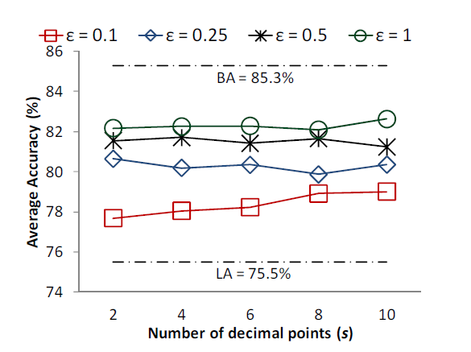
Scaling Impact

Slide 53
Outline
Motivation
Problem Statement
Related Work
Background
Two-Party Differentially Private Data Release
Performance Analysis
Conclusion

Slide 54
Conclusion
Data release algorithm
Two-party
Differentially-private
Secure
Horizontally-partitioned
Non-interactive setting

Slide 55
Future Work
Consider different scenarios
Two parties vs. multiple parties
Semi-honest vs. malicious adversary model
Horizontally vs. Vertically partitioned data
For all these scenarios, we need efficient algorithms

